Slide 1
DataBase Management System Lab (4CS4-22) Experiment No. -2 Topic to be covered : Execute Different constraints Like Primary key, Foreign key, Not Null, unique and check

Slide 2
SQL Constraints
SQL constraints are used to specify rules for data in a table.
Constraints are used to limit the type of data that can go into a table.
This ensures the accuracy and reliability of the data in the table.
If there is any violation between the constraint and the data action, the action is aborted.
Constraints can be column level or table level.
Column level constraints apply to a column, and table level constraints apply to the whole table.
Constraints can be specified when the table is created with the CREATE TABLE statement, or after the table is created with the ALTER TABLE statement.

Slide 3
NOT NULL Constraint − Ensures that a column cannot have NULL value.
DEFAULT Constraint − Provides a default value for a column when none is specified.
UNIQUE Constraint − Ensures that all values in a column are different.
PRIMARY Key − Uniquely identifies each row/record in a database table.
FOREIGN Key − Uniquely identifies a row/record in any of the given database table.
CHECK Constraint − The CHECK constraint ensures that all the values in a column satisfies certain conditions.
Syntax:
CREATE TABLE table_name ( column1 datatype constraint, column2 datatype constraint, column3 datatype constraint, .... );

Slide 4
SQL NOT NULL Constraint:
By default, a column can hold NULL values.
The NOT NULL constraint enforces a column to NOT accept NULL values.
This enforces a field to always contain a value, which means that you cannot insert a new record, or update a record without adding a value to this field.
SQL NOT NULL on CREATE TABLE
CREATE TABLE Student(Id INTEGER, LastName TEXT NOT NULL, FirstName TEXT NOT NULL, City VARCHAR(35));
INSERT INTO Student VALUES(1, 'Hanks', 'Peter', 'New York');
INSERT INTO Student VALUES(2, NULL, 'Amanda', 'Florida');

Slide 5
SQL NOT NULL on ALTER TABLE
To create a NOT NULL constraint on the "Age" column when the "Persons" table is already created, use the following SQL:
ALTER TABLE table_name
Modify COLUMN col_name data_type NOT NULL;

Slide 6
SQL UNIQUE Constraint
The UNIQUE constraint ensures that all values in a column are different.
Both the UNIQUE and PRIMARY KEY constraints provide a guarantee for uniqueness
for a column or set of columns.
A PRIMARY KEY constraint automatically has a UNIQUE constraint.
However, you can have many UNIQUE constraints per table, but only
one PRIMARY KEY constraint per table.
SQL UNIQUE Constraint on CREATE TABLE
CREATE TABLE ShirtBrands
(Id INTEGER, BrandName VARCHAR(40) UNIQUE, Size VARCHAR(30));
INSERT INTO ShirtBrands(Id, BrandName, Size) VALUES(1, 'Pantaloons', 38),
(2, 'Cantabil', 40);
INSERT INTO ShirtBrands(Id, BrandName, Size) VALUES(1, 'Raymond', 38),
(2, 'Cantabil', 40);

Slide 7
To name a UNIQUE constraint, and to define a UNIQUE constraint on multiple columns, use the following
SQL syntax:
CREATE TABLE Persons ( ID int NOT NULL, LastName varchar(255) NOT NULL, FirstName varchar(255), Age int, CONSTRAINT UC_Person UNIQUE (ID,LastName) );
SQL UNIQUE Constraint on ALTER TABLE:
ALTER TABLE Persons ADD UNIQUE (ID);
ALTER TABLE Persons ADD CONSTRAINT UC_Person UNIQUE (ID,LastName);

Slide 8
DROP a UNIQUE Constraint
ALTER TABLE Persons DROP CONSTRAINT UC_Person;
SQL PRIMARY KEY Constraint
The PRIMARY KEY constraint uniquely identifies each record in a table.
Primary keys must contain UNIQUE values, and cannot contain NULL values.
A table can have only ONE primary key; and in the table, this primary key can consist of single or multiple columns (fields).
SQL PRIMARY KEY on CREATE TABLE:
CREATE TABLE Persons ( ID int NOT NULL PRIMARY KEY, LastName varchar(255) NOT NULL, FirstName varchar(255), Age int );

Slide 9
CREATE TABLE Persons (
ID int NOT NULL PRIMARY KEY,
Name varchar(45) NOT NULL,
Age int,
City varchar(25));
INSERT INTO Persons(Id, Name, Age, City)
VALUES (1,'Robert', 15, 'Florida') ,
(2, 'Joseph', 35, 'California'),
(3, 'Peter', 40, 'Alaska');
INSERT INTO Persons(Id, Name, Age, City)
VALUES (1,'Stephen', 15, 'Florida');

Slide 10
To allow naming of a PRIMARY KEY constraint, and for defining a PRIMARY KEY constraint on multiple columns, use the following SQL syntax:
CREATE TABLE Persons ( ID int NOT NULL, LastName varchar(255) NOT NULL, FirstName varchar(255), Age int, CONSTRAINT PK_Person PRIMARY KEY (ID,LastName) );
In the example above there is only ONE PRIMARY KEY (PK_Person). However, the VALUE of the primary key is made up of TWO COLUMNS (ID + LastName).
SQL PRIMARY KEY on ALTER TABLE:
ALTER TABLE Persons ADD CONSTRAINT PK_Person PRIMARY KEY (ID,LastName);
DROP a PRIMARY KEY Constraint:
ALTER TABLE Persons DROP CONSTRAINT PK_Person;

Slide 11
SQL CHECK Constraint
The CHECK constraint is used to limit the value range that can be placed in a column.
If you define a CHECK constraint on a column it will allow only certain values for this column.
CREATE TABLE Persons ( ID int NOT NULL, LastName varchar(255) NOT NULL, FirstName varchar(255), Age int CHECK (Age>=18) );
CREATE TABLE Persons ( ID int NOT NULL, LastName varchar(255) NOT NULL, FirstName varchar(255), Age int, City varchar(255), CONSTRAINT CHK_Person CHECK (Age>=18 AND City='Sandnes') );

Slide 12
SQL CHECK on ALTER TABLE:
ALTER TABLE Persons ADD CHECK (Age>=18);
ALTER TABLE Persons ADD CONSTRAINT CHK_PersonAge CHECK (Age>=18 AND City='Sandnes');
DROP a CHECK Constraint
ALTER TABLE Persons DROP CONSTRAINT CHK_PersonAge;

Slide 13
AUTO INCREMENT Field:
Auto-increment allows a unique number to be generated automatically when a new record is inserted into a table.
Often this is the primary key field that we would like to be created automatically every time a new record is inserted.
Syntax for SQL Server
CREATE TABLE Animals(
id int NOT NULL AUTO_INCREMENT,
name CHAR(30) NOT NULL,
PRIMARY KEY (id));
INSERT INTO Animals (name) VALUES
('Tiger'),('Dog'),('Penguin'),
('Camel'),('Cat'),('Ostrich');

Slide 14
SQL DEFAULT Constraint
The DEFAULT constraint is used to set a default value for a column.
The default value will be added to all new records, if no other value is specified.
CREATE TABLE Persons (
ID int NOT NULL,
Name varchar(45) NOT NULL,
Age int,
City varchar(25) DEFAULT 'New York'
);
INSERT INTO Persons(Id, Name, Age, City)
VALUES (1,'Robert', 15, 'Florida'),
(2, 'Joseph', 35, 'California'),
(1,'Brayan', 15);

Slide 15
SQL DEFAULT on ALTER TABLE
ALTER TABLE Persons ADD CONSTRAINT df_City DEFAULT 'Sandnes' FOR City;
DROP a DEFAULT Constraint
ALTER TABLE Persons ALTER COLUMN City DROP DEFAULT;

Slide 16
SQL FOREIGN KEY Constraint:
This constraint is used to link two tables together. It is also known as the referencing key. A foreign key column matches the primary key field of another table. It means a foreign key field in one table refers to the primary key field of another table.
The FOREIGN KEY constraint is used to prevent actions that would destroy links between tables.
A FOREIGN KEY is a field (or collection of fields) in one table, that refers to the PRIMARY KEY in another table.
The table with the foreign key is called the child table, and the table with the primary key is called the referenced or parent table.

Slide 17
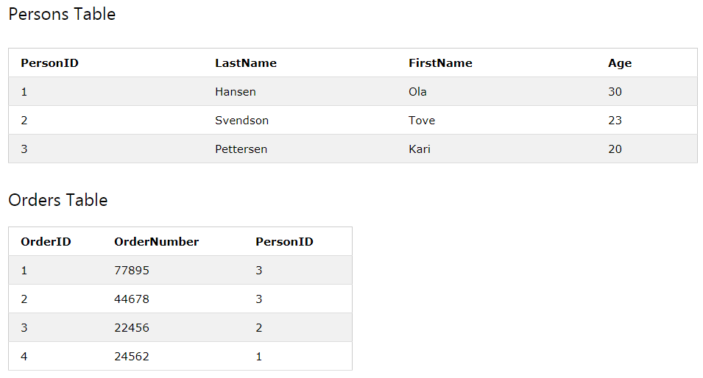

Slide 18
CREATE TABLE Persons (
Person_ID int NOT NULL PRIMARY KEY,
Name varchar(45) NOT NULL,
Age int,
City varchar(25)
);
CREATE TABLE Orders (
Order_ID int NOT NULL PRIMARY KEY,
Order_Num int NOT NULL,
Person_ID int,
FOREIGN KEY (Person_ID) REFERENCES Persons(Person_ID)
);
In the above table structures, we can see that the "Person_ID" field in the "Orders" table points to the "Person_ID" field in the "Persons" table. The "Person_ID" is the PRIMARY KEY in the "Persons" table, while the "Person_ID" column of the "Orders" table is a FOREIGN KEY.
The FOREIGN KEY constraint prevents invalid data from being inserted into the foreign key column, because it has to be one of the values contained in the parent table.

Slide 19
SQL FOREIGN KEY on ALTER TABLE:
ALTER TABLE Orders ADD FOREIGN KEY (PersonID) REFERENCES Persons(PersonID);
DROP a FOREIGN KEY Constraint
ALTER TABLE Orders DROP CONSTRAINT FK_PersonOrder;

